Slide 1
Object Oriented Programming(Java) Lecture 15

Slide 2
Content
Java Applet
Advantage of Applet
Hierarchy of Applet
Lifecycle of Java Applet
Simple example of Applet

Slide 3
Java Applet :
Applet is a special type of program that is embedded in the webpage to generate the dynamic content. It runs inside the browser and works at client side.

Slide 4
Advantage of Applet :
There are many advantages of applet. They are as follows:
It works at client side so less response time.
Secured
It can be executed by browsers running under many platforms, including Linux, Windows, Mac Os etc.

Slide 5
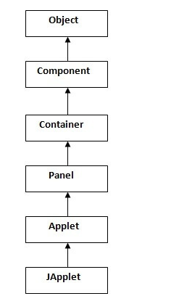
Hierarchy of Applet :

Slide 6
Lifecycle of Java Applet :
Applet is initialized.
Applet is started.
Applet is painted.
Applet is stopped.
Applet is destroyed.

Slide 7
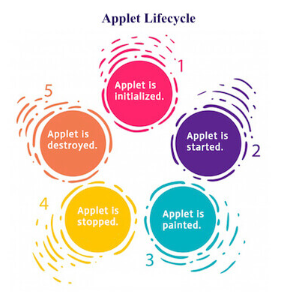
Lifecycle of Java Applet :

Slide 8
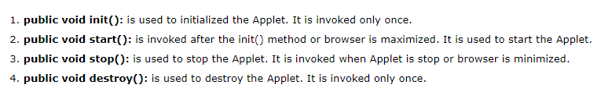
java.applet.Applet class :
For creating any applet java.applet.Applet class must be inherited. It provides 4 life cycle methods of applet.

Slide 9
java.awt.Component class :
The Component class provides 1 life cycle method of applet.
public void paint(Graphics g): is used to paint the Applet. It provides Graphics class object that can be used for drawing oval, rectangle, arc etc.

Slide 10
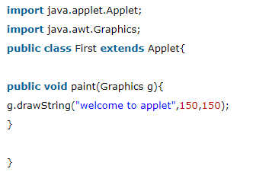
Simple example of Applet :

Slide 11
References :
https://www.javatpoint.com/java-applet

Slide 12
Thanks

